Slide 1
Recent study of interdisciplinary field of genomic data science.
Banaras Hindu University, India.
“Transcriptome sequencing (rna-sequencing) human brain, comparing fetal and adult using novel genomic data science approach”
Ajay Kumar (18419CMP003)
Dr. Manoj Kumar Singh (Supervisor)
Signal Image Language Processing Lab (SILP)
Department of Computer Science, Institute of Science
Banaras Hindu University (BHU), Varanasi-221005, INDIA.
Email: ajay.ducs@ieee.org
August 22, 2020
Notes:
•

Slide 2
Outline
Introduction
Problem statement
Literature review
Proposed approach
Implementation details
Results
Conclusion and future scopes
Comments
References

Slide 3
Introduction: Genomic Data Science
CS- Computer Science; B- Biology; M-Mathematics; GDS- Genomic Data Science

Slide 4
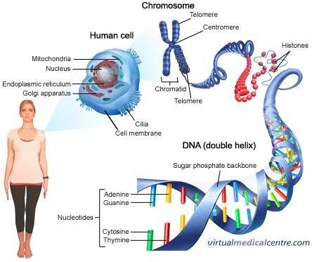
Introduction: Genomic Data Science
The complete set nucleic acid in an organism is called “Genome”.
Human genome consists of approximately 3.2 billion nucleotides.
DNA is double helix structured chemical structure made of four phosphate, sugar and nitrogenous based includes Adenine (A), Guanine (G), Thymine (T)/Uracil (U) and Cytosine (C).
Human Cell, DNA and Nitrogenous Bases.
DNA is also referred as genetic material because it passes from parents to their offsprings and also, In human, Ribonucleic acid (RNA) transfers from mother to child thus it gives more expression of mother rather father.

Slide 5
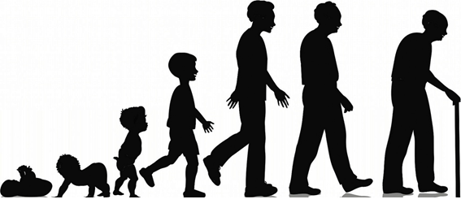
Problem Statement
Problem or Research Question: How human being changes from fetal to an adult? More precisely, What is the difference between gene expression of fetal and adult of human being?
Human life cycle

Slide 6
Literature Review
Andre E. Jaffe et al, “Developmental and genetic regulation of the human cortex transcriptome illuminate schizophrenia pathogenesis,”
This research is motivated by previous research that explored these changes and found widespread differences in gene expression comparing fetal to later in life samples. They used microarray technologies which used pre-defined probe sequences to only query known gene sequence. And additionally existing RNA sequencing data sets like the BrainSpan project only has existing feature counts like genes and exons which might also limit biological discovery for age related changes in expression. And so we choose to work on unbiased snapshot of the transcriptome RNA-sequencing data generated at the LIEBER INSTITUTE FOR BRAIN DEVELOPMENT.

Slide 7
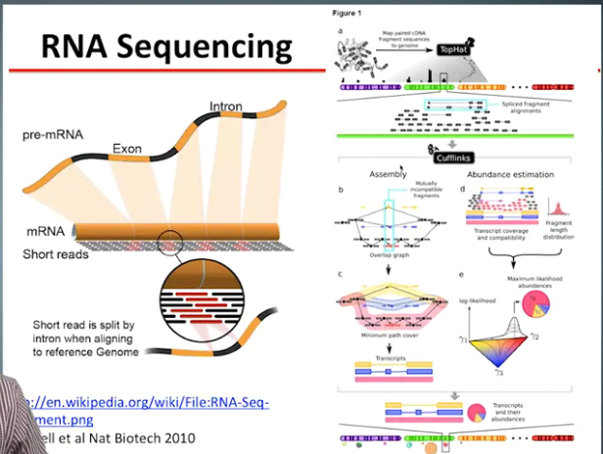
Literature Review
RNA sequencing

Slide 8
Proposed Approach
Algorithmic steps for the analysis are as follows:
1. Download the raw sequence data and meta-data (phenotypic information and
technological information) from the public database.
2. Preprocess the data.
3. Align the data with reference human genome (hg19).
4. Perform quality control on the aligned data.
5. Calculate express measurement at gene count level.
6. Perform exploratory analysis to identify major feature of the data and figure out which model is to build.
7. Fit this statistical model to identify genes that are different from fetal human brain to adult human brain.
8. Integrate results and answer the fundamental biological question.

Slide 9
Proposed Approach
The following tools are being use for the analysis:
i. Galaxy Virtual Lab (GVL-GUI based workflow analysis environment)
ii. Bowtie2 (For aligning the raw RNA-Seq data)
iii. FastQC
iv. FeatureCount
v. R-programming and Bioconductors
vi. DESeq

Slide 10
Implementation Details
The steps are as follows:
Collecting raw data/ metadata/ samples
Aligning the genome dataset
Perform quality control on alignments
Calculate expression measurement at gene count level
Exploratory analysis
Integrate findings – Result section

Slide 11
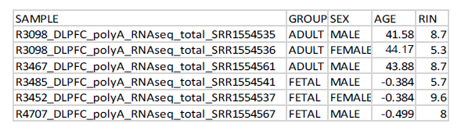
Implementation Details: RAW DATA/META DATA
(Phenotypic information of the sample datasets)

Slide 12
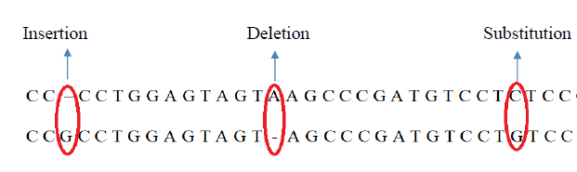
Implementation Details: Alignment
(Alignment in genomics (Indels))

Slide 13
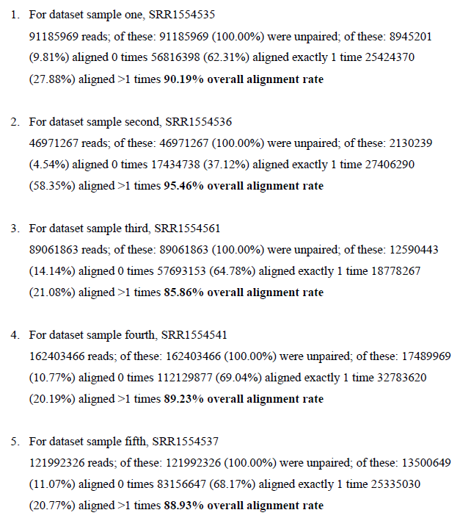
Implementation Details: Alignment-I

Slide 14
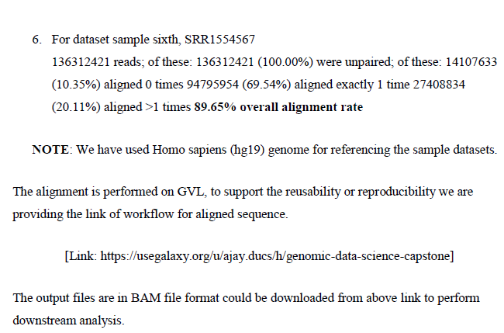
Implementation Details: Alignment-II

Slide 15
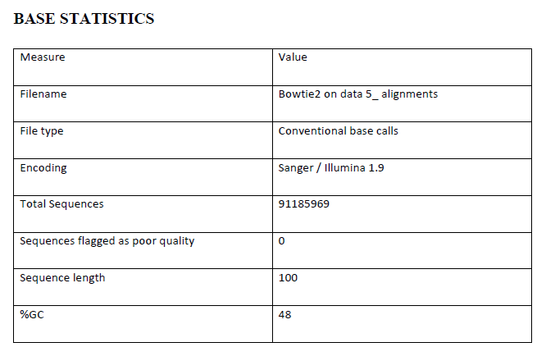
Implementation Details: Quality Control

Slide 16
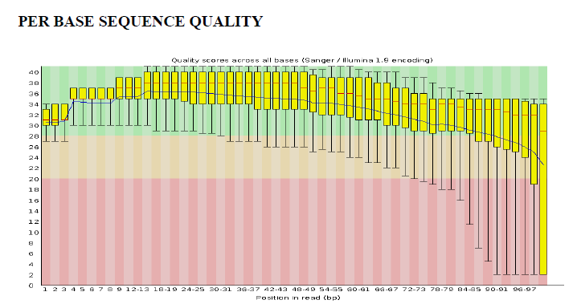
Implementation Details: Quality Control

Slide 17
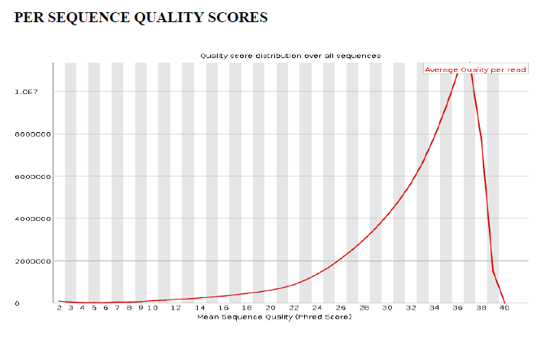
Implementation Details: Quality Control

Slide 18
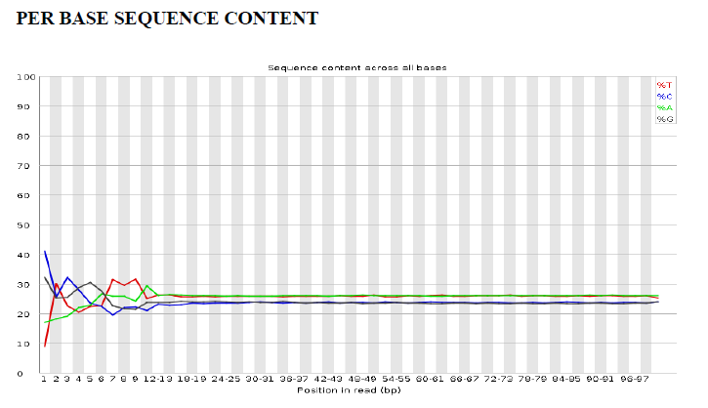
Implementation Details: Quality Control

Slide 19
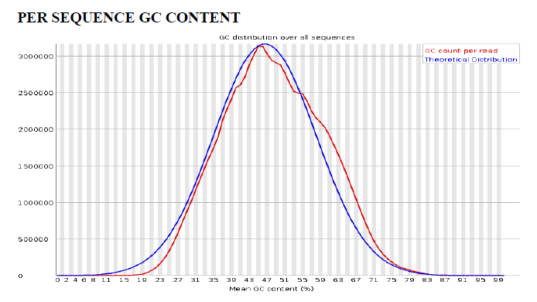
Implementation Details: Quality Control

Slide 20
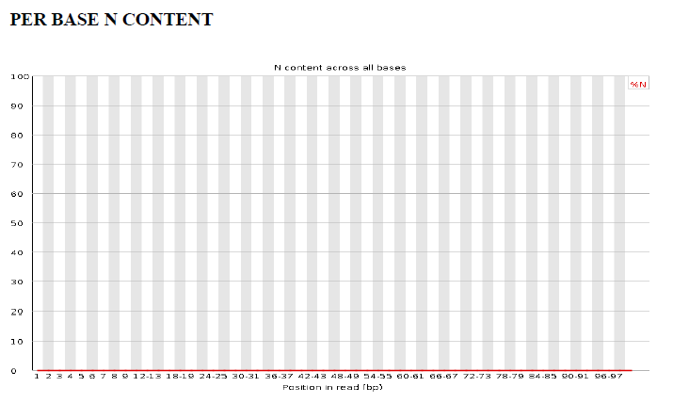
Implementation Details: Quality Control

Slide 21
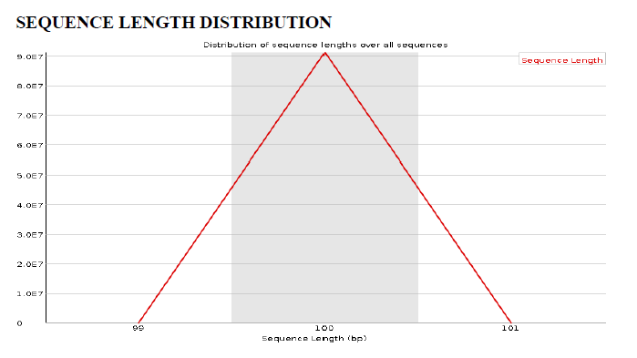
Implementation Details: Quality Control

Slide 22
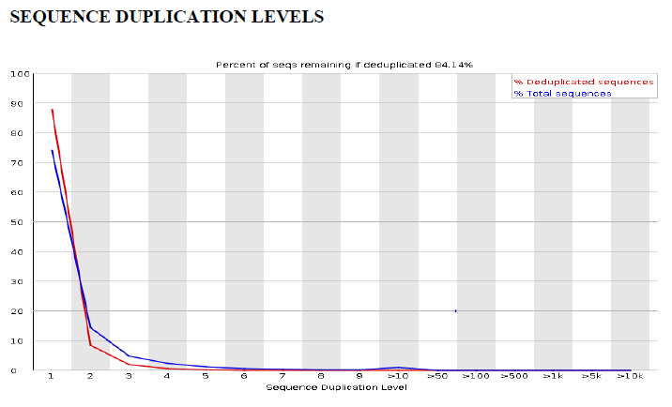
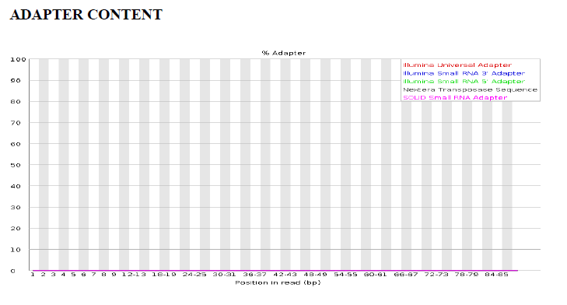
Implementation Details: Quality Control

Slide 23
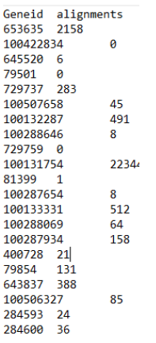
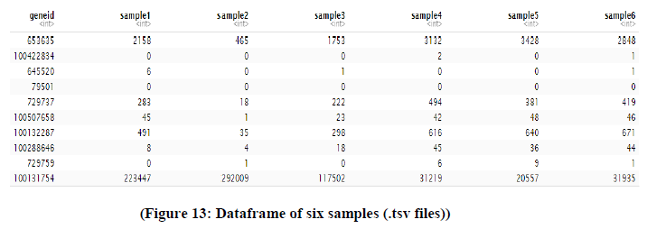
Implementation Details: Expression Measurement
(.tsv file format (genes))

Slide 24
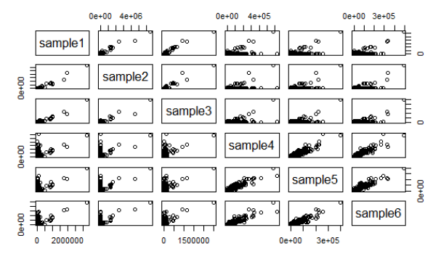
Results
AFTER PERFORMING EXPLORATORY ANALYSIS:
(Plot representation of six samples)

Slide 25
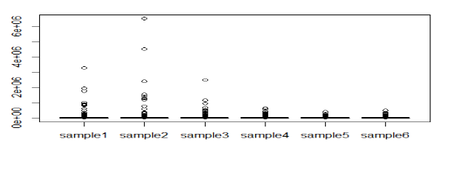
Results
(Barplot representation of our six samples)

Slide 26
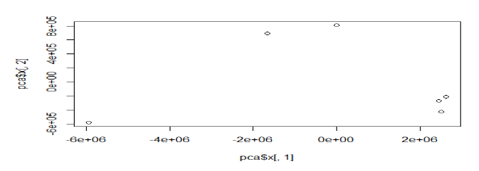
Results
(PCA plot representation of our six samples)

Slide 27
Conclusion and Future Scope
Encourages interdisciplinary study of genomic data science by demonstrating to work on real life problem statement and supporting the answer with scientific insights using recently enhanced tools/softwares/methodologies.
We can use similar experiment with more samples and also, with samples from different ages to see the pattern in RNA-seq data that it is changing? If there is any pattern or particular gene responsible for growth of human being. If that happens, we could research for human age reversal.
Moreover, we could treat abnormal untreated diseases in womb only using CRISPR technology.

Slide 28
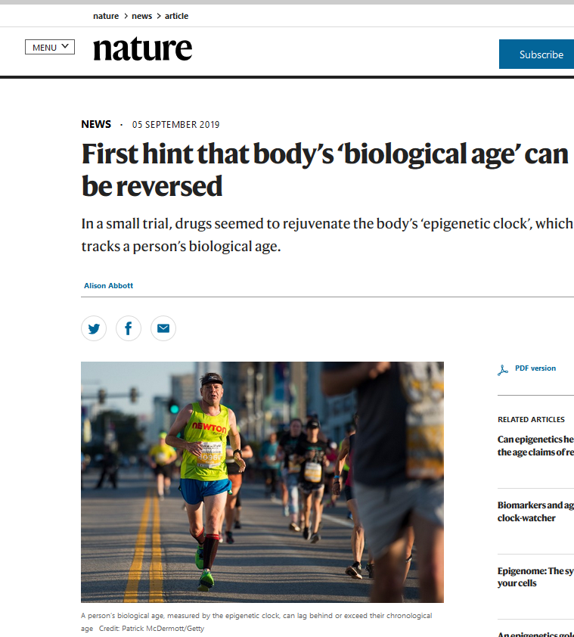
Conclusion and Future Scope

Slide 29
Comments
Question: What is the motivation behind the project?
Answer: Computer science hurdled from the earlier traditional programming paradigm into modern programming paradigm of ML, DL or AI. Similarly, sanger sequencing or microarray technologies that are replaced by NGS and GDS.
Conclusion, use of cutting edge technology in genome analysis and gene editing can produce better and even significant results. That may be worth.
Here is the only try for something better.

Slide 30

Collaborators
Prof. Jeff Leek &
Prof. Liliana flora

Slide 31




Resources
Centre for Interdisciplinary
Mathematical Sciences
(Resources)
Genomic Data Science Specialization
National Center for Biotechnology
Information : Real-life Datasets
Genomics Virtual Lab

Slide 32
References
M. J. Streubel, “What is Computer Science? Computer,” 2003, [Online]. Available: http://www.cs.bu.edu/AboutCS/WhatIsCS.pdf. V. R. H. and H. D. Huskey, “‘Lady Lovelace and Charles Babbage,’ in Annals of the History of Computing,” Ann. Hist. Comput., vol. 2, pp. 299–329, [Online]. Available: https://ieeexplore.ieee.org/document/4639398. O. Kharkovyna, “Machine Learning vs Traditional Programming.” https://towardsdatascience.com/machine- learning-vs-traditional-programming-c066e39b5b17. P. Wang, “On Defining Artificial Intelligence,” J. Artif. Gen. Intell., vol. 10, no. 2, pp. 1–37, 2019, doi: 10.2478/jagi-2019-0002. R. A. Irizarry, “The Role of Academia in Data Science Education,” Harvard Data Sci. Rev., pp. 1–8, 2020, doi: 10.1162/99608f92.dd363929. J. Zou, M. Huss, A. Abid, P. Mohammadi, A. Torkamani, and A. Telenti, “A primer on deep learning in genomics,” Nat. Genet., vol. 51, no. 1, pp. 12–18, 2019, doi: 10.1038/s41588-018-0295-5. M. D. Christopher P. Austin, “Bioinformatics.” https://www.genome.gov/genetics-glossary/Bioinformatics (accessed May 27, 2020). J. Leek, Genomic Data Science. 2015. Nature, “genomics,” 2014. https://www.nature.com/scitable/definition/genomics-126/. F. P. and others E. Bianconi, A. Piovesan, F. Facchin, A. Beraudi, R. Casadei, F. Frabetti, L. Vitale, M. C. Pelleri, S. Tassani, “An estimation of the number of cells in the human body,” Ann. Hum. Biol., vol. 40, pp. 463–471, 2013, [Online]. Available: https://www.tandfonline.com/doi/abs/10.3109/03014460.2013.807878. N. H. G. R. Institute, “A brief guide to genomics,” 2019. . N. H. G. R. Institute, “Transcriptome Fact Sheet,” 2015, [Online]. Available: https://www.genome.gov/about-genomics/fact-sheets/Transcriptome-Fact-Sheet. S. B. and J. H. M. Garrels, J. I., “Proteome,” Encyclopedia of Genetics. pp. 1575–1578, 2001.

Slide 33
References
kasper daniel hansen et al James Taylor, Jacob pritt, Liliana florea, “Genomic Data Science Specialization,” 2015. https://www.coursera.org/specializations/genomic-data-science. A. E. Jaffe et al., “HHS Public Access transcriptome illuminate schizophrenia pathogenesis,” vol. 21, no. 8, pp. 1117–1125, 2019, doi: 10.7303/syn12299750. F. C. P. Navarro, H. Mohsen, C. Yan, S. Li, M. Gu, and W. Meyerson, “Genomics and data science : an application within an umbrella,” pp. 1–11, 2019. “GALAXY VIRTUAL LAB.” https://usegalaxy.org/. J. H. University, “BOWTIE2.” http://bowtie-bio.sourceforge.net/bowtie2/manual.shtml (accessed Jul. 04, 2020). S. Andrews, “FastQC 1 . 1 What is FastQC 2 . Basic Operations 2 . 1 Opening a Sequence file,” 2010, [Online]. Available: http://www.bioinformatics.babraham.ac.uk/projects/fastqc/. W. Shi and Y. Liao, “Rsubread / Subread Users Guide,” no. October, 2019. T. Hothorn and B. S. Everitt, “- An Introduction to R,” A Handb. Stat. Anal. using R, vol. 2, pp. 32–55, 2020, doi: 10.1201/b17081-8. S. Anders and W. Huber, “Differential expression of RNA-Seq data at the gene level–the DESeq package,” DESq Man., pp. 1–28, 2012, doi: 10.1016/S0926-3373(02)00165-0. S. S. D. United States Bureau of the Census, Software and Standards Management Branch, “Survey Design and Statistical Methodology Metadata,” no. section 3.3.7, p. 14, [Online]. Available: https://stats.oecd.org/glossary/detail.asp?ID=542. B. Langmead, C. Wilks, V. Antonescu, and R. Charles, “Scaling read aligners to hundreds of threads on general-purpose processors,” Bioinformatics, vol. 35, no. 3, pp. 421–432, 2019.

Slide 34
Thank You!

Slide 35
COMPREHENSIVE VIVA - 508

Slide 36
READING ELECTIVE - 509
Instructor: Prof. Shalabh (IIT Kanpur)
Subject: “Descriptive Statistics with R-software”
Week 1: Introduction to R, basic functions, matrix, splicing
Week 2: Objectives of Statistical Analysis, Graphical tools, Analytical tools, absolute and relative frequency, cumulative frequency.
Week 3: Graphical tools: Barplot, pie, pie3d, histogram, kernel density plot, stem and leaf plot.
Week 4: Analytical tools: mean, median, mode, quantiles, geometric mean, harmonic mean, dispersion, Range, IQRange.
Week 5: Variation in Data: absolute deviation, absolute mean deviation, mean square error, variance, standard deviation, coefficient of variation, boxplot.
Week 6: Moments: Raw moments, central moments, sheppard’s correction for moments, absolute moments, skewness, kurtosis, normal distribution.
Week 7: Association of two variables, bivariate plots, scatter plot with smooth curve, smooth scatter, QQ-plot, 3D-scatter plot, Correlation coefficient.
Week 8: Spearman’s rank correlation coefficient, pearson’s chi-squared statistics, cramer’s V statistics, fitting of linear model.

